Slide 1
Chapter 3: Introduction to SQL

Slide 2
Outline
Overview of The SQL Query Language
SQL Data Definition
Basic Query Structure of SQL Queries
Additional Basic Operations
Set Operations
Null Values
Aggregate Functions
Nested Subqueries
Modification of the Database
Notes:
1

Slide 3
SQL Parts
DML -- provides the ability to query information from the database and to insert tuples into, delete tuples from, and modify tuples in the database.
integrity – the DDL includes commands for specifying integrity constraints.
View definition -- The DDL includes commands for defining views.
Transaction control –includes commands for specifying the beginning and ending of transactions.
Embedded SQL and dynamic SQL -- define how SQL statements can be embedded within general-purpose programming languages.
Authorization – includes commands for specifying access rights to relations and views.

Slide 4
Data Definition Language
The SQL data-definition language (DDL) allows the specification of information about relations, including:
The schema for each relation.
The type of values associated with each attribute.
The Integrity constraints
The set of indices to be maintained for each relation.
Security and authorization information for each relation.
The physical storage structure of each relation on disk.

Slide 5
Domain Types in SQL
char(n). Fixed length character string, with user-specified length n.
varchar(n). Variable length character strings, with user-specified maximum length n.
int. Integer (a finite subset of the integers that is machine-dependent).
smallint. Small integer (a machine-dependent subset of the integer domain type).
numeric(p,d). Fixed point number, with user-specified precision of p digits, with d digits to the right of decimal point. (ex., numeric(3,1), allows 44.5 to be stores exactly, but not 444.5 or 0.32)
real, double precision. Floating point and double-precision floating point numbers, with machine-dependent precision.
float(n). Floating point number, with user-specified precision of at least n digits.
More are covered in Chapter 4.

Slide 6
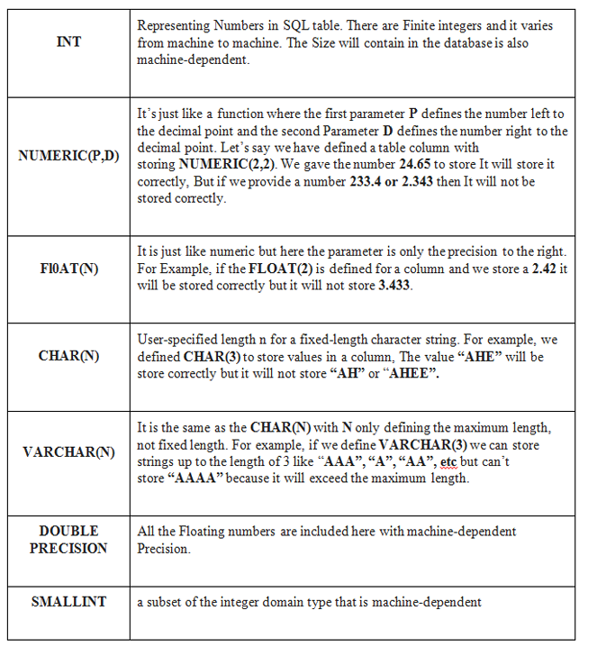
Domain Types in SQL

Slide 7
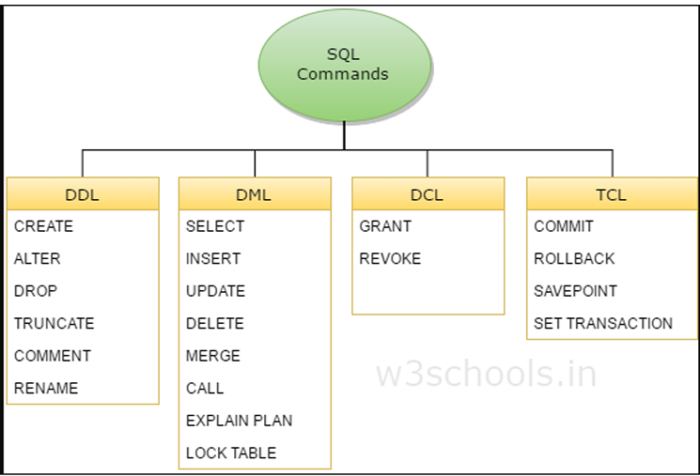

Slide 8
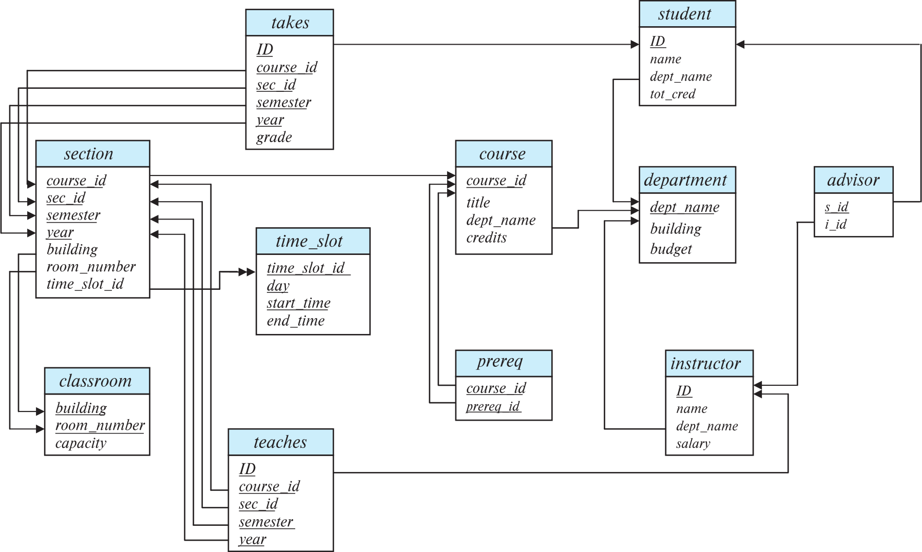
Schema Diagram for University Database

Slide 9
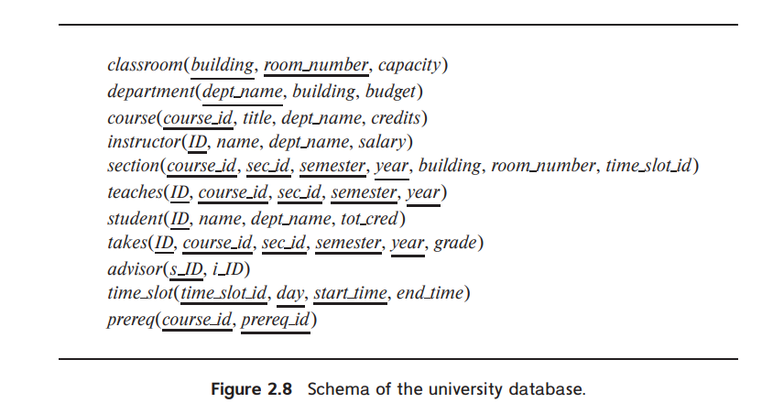

Slide 10
Create Table Construct
An SQL relation is defined using the create table command:
create table r
(A₁ D₁, A₂ D₂, ..., A_{n} D_{n},
(integrity-constraint₁),
...,
(integrity-constraint_{k}))
  r is the name of the relation
  each A_{i} is an attribute name in the schema of relation r
  D_{i} is the data type of values in the domain of attribute A_{i}
Example:
create table instructor (
ID char(5),
name varchar(20),
dept_name varchar(20),
salary numeric(8,2))

Slide 11
Integrity Constraints in Create Table
Types of integrity constraints
  primary key (A₁, ..., A_{n} )
  foreign key (A_{m}, ..., A_{n} ) references r
  not null
SQL prevents any update to the database that violates an integrity constraint.
Example:
create table instructor (
ID char(5),
name varchar(20) not null,
dept_name varchar(20),
salary numeric(8,2),
primary key (ID),
foreign key (dept_name) references department);

Slide 12
And a Few More Relation Definitions
create table student (
ID varchar(5),
name varchar(20) not null,
dept_name varchar(20),
tot_cred numeric(3,0),
primary key (ID),
foreign key (dept_name) references department);
create table takes (
ID varchar(5),
course_id varchar(8),
sec_id varchar(8),
semester varchar(6),
year numeric(4,0),
grade varchar(2),
primary key (ID, course_id, sec_id, semester, year) ,
foreign key (ID) references student,
foreign key (course_id, sec_id, semester, year) references section);

Slide 13
And more still
create table course (
course_id varchar(8),
title varchar(50),
dept_name varchar(20),
credits numeric(2,0),
primary key (course_id),
foreign key (dept_name) references department);

Slide 14
Updates to tables
Insert
  insert into instructor values ('10211', 'Smith', 'Biology', 66000);
Delete
  Remove all tuples from the student relation
    delete from student
Drop Table
  drop table r
Alter
  alter table r add A D
    where A is the name of the attribute to be added to relation r and D is the domain of A.
    All exiting tuples in the relation are assigned null as the value for the new attribute.
  alter table r drop A
    where A is the name of an attribute of relation r
    Dropping of attributes not supported by many databases.

Slide 15
Basic Query Structure
A typical SQL query has the form:
select A₁, A₂, ..., A_{n}
from r₁, r₂, ..., r_{m}
where P
  A_{i} represents an attribute
  R_{i} represents a relation
  P is a predicate.
The result of an SQL query is a relation.
Notes:
2

Slide 16
The select Clause
The select clause lists the attributes desired in the result of a query
  corresponds to the projection operation of the relational algebra
Example: find the names of all instructors:
select name
from instructor
NOTE: SQL names are case insensitive (i.e., you may use upper- or lower-case letters.)
  E.g., Name ≡ NAME ≡ name
  Some people use upper case wherever we use bold font.
Notes:
3

Slide 17
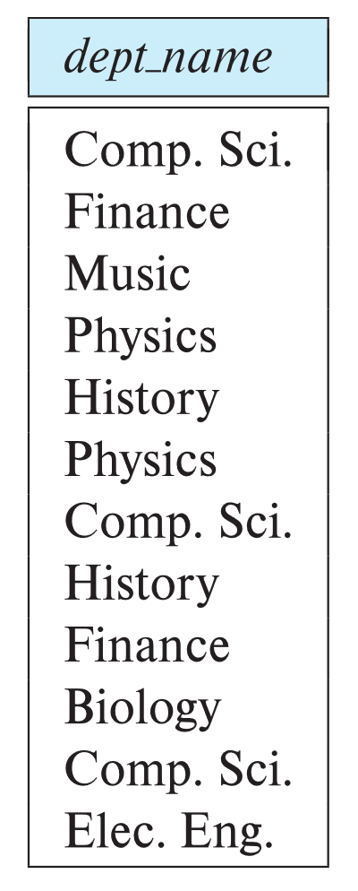
The select Clause (Cont.)
SQL allows duplicates in relations as well as in query results.
To force the elimination of duplicates, insert the keyword distinct after select.
Find the department names of all instructors, and remove duplicates
select distinct dept_name
from instructor
The keyword all specifies that duplicates should not be removed.
select all dept_name
from instructor
Notes:
4

Slide 18
The select Clause (Cont.)
An asterisk in the select clause denotes “all attributes”
select *
from instructor
An attribute can be a literal with no from clause
select '437'
  Results is a table with one column and a single row with value “437”
  Can give the column a name using:
  select '437' as FOO
An attribute can be a literal with from clause
select 'A'
from instructor
  Result is a table with one column and N rows (number of tuples in the instructors table), each row with value “A”
Notes:
5

Slide 19
The select Clause (Cont.)
The select clause can contain arithmetic expressions involving the operation, +, –, ∗, and /, and operating on constants or attributes of tuples.
  The query:
  select ID, name, salary/12
  from instructor
  would return a relation that is the same as the instructor relation, except that the value of the attribute salary is divided by 12.
  Can rename “salary/12” using the as clause:
  select ID, name, salary/12 as monthly_salary
Notes:
5

Slide 20
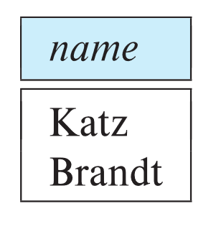
The where Clause
The where clause specifies conditions that the result must satisfy
  Corresponds to the selection predicate of the relational algebra.
To find all instructors in Comp. Sci. dept
select name
from instructor
where dept_name = 'Comp. Sci.'
SQL allows the use of the logical connectives and, or, and not
The operands of the logical connectives can be expressions involving the comparison operators <, <=, >, >=, =, and <>.
Comparisons can be applied to results of arithmetic expressions
To find all instructors in Comp. Sci. dept with salary > 70000
  select name
  from instructor
  where dept_name = 'Comp. Sci.' and salary > 70000
Notes:
6

Slide 21
The from Clause
The from clause lists the relations involved in the query
  Corresponds to the Cartesian product operation of the relational algebra.
Find the Cartesian product instructor X teaches
select ∗
from instructor, teaches
  generates every possible instructor – teaches pair, with all attributes from both relations.
  For common attributes (e.g., ID), the attributes in the resulting table are renamed using the relation name (e.g., instructor.ID)
Cartesian product not very useful directly, but useful combined with where-clause condition (selection operation in relational algebra).
Notes:
8

Slide 22
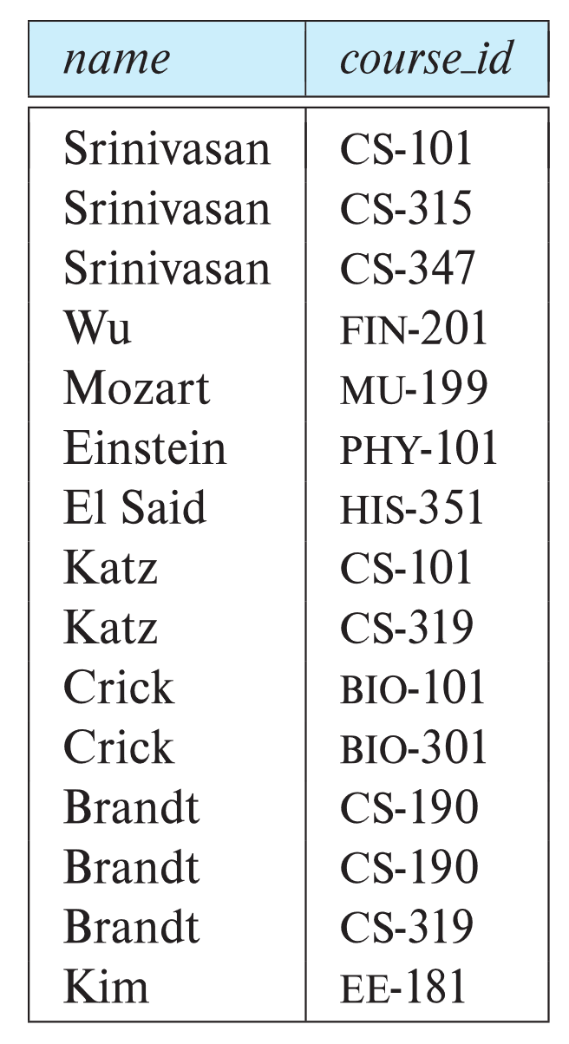
Examples
Find the names of all instructors who have taught some course and the course_id
  select name, course_id
  from instructor , teaches
  where instructor.ID = teaches.ID
Find the names of all instructors in the Art department who have taught some course and the course_id
  select name, course_id
  from instructor , teaches
  where instructor.ID = teaches.ID
  and instructor. dept_name = 'Art'
Notes:
9

Slide 23
The Rename Operation
The SQL allows renaming relations and attributes using the as clause:
old-name as new-name
Find the names of all instructors who have a higher salary than
some instructor in 'Comp. Sci'.
  select distinct T.name
  from instructor as T, instructor as S
  where T.salary > S.salary and S.dept_name = 'Comp. Sci.’
Keyword as is optional and may be omitted
instructor as T ≡ instructor T
Notes:
9

Slide 24
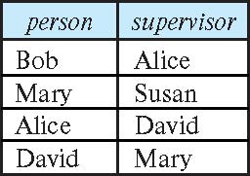
Self Join Example
Relation emp-super
Find the supervisor of “Bob”
Find the supervisor of the supervisor of “Bob”
Can you find ALL the supervisors (direct and indirect) of “Bob”?
Notes:
9

Slide 25
String Operations
SQL includes a string-matching operator for comparisons on character strings. The operator like uses patterns that are described using two special characters:
  percent ( % ). The % character matches any substring.
  underscore ( _ ). The _ character matches any character.
Find the names of all instructors whose name includes the substring “dar”.
select name
from instructor
where name like '%dar%'
Match the string “100%”
like '100 \%' escape '\'
in that above we use backslash (\) as the escape character.

Slide 26
String Operations (Cont.)
Patterns are case sensitive.
Pattern matching examples:
  'Intro%' matches any string beginning with “Intro”.
  '%Comp%' matches any string containing “Comp” as a substring.
  '_ _ _' matches any string of exactly three characters.
  '_ _ _ %' matches any string of at least three characters.
SQL supports a variety of string operations such as
  concatenation (using “||”)
  converting from upper to lower case (and vice versa)
  finding string length, extracting substrings, etc.

Slide 27
Ordering the Display of Tuples
List in alphabetic order the names of all instructors
select distinct name
from instructor
order by name
We may specify desc for descending order or asc for ascending order, for each attribute; ascending order is the default.
  Example: order by name desc
Can sort on multiple attributes
  Example: order by dept_name, name

Slide 28
Where Clause Predicates
SQL includes a between comparison operator
Example: Find the names of all instructors with salary between $90,000 and $100,000 (that is, ≥ $90,000 and ≤ $100,000)
  select name
  from instructor
  where salary between 90000 and 100000
Tuple comparison
  select name, course_id
  from instructor, teaches
  where (instructor.ID, dept_name) = (teaches.ID, 'Biology');
Notes:
7

Slide 29
Set Operations
Find courses that ran in Fall 2017 or in Spring 2018
(select course_id from section where sem = 'Fall' and year = 2017)
union
(select course_id from section where sem = 'Spring' and year = 2018)
Find courses that ran in Fall 2017 and in Spring 2018
(select course_id from section where sem = 'Fall' and year = 2017)
intersect
(select course_id from section where sem = 'Spring' and year = 2018)
Find courses that ran in Fall 2017 but not in Spring 2018
(select course_id from section where sem = 'Fall' and year = 2017)
except
(select course_id from section where sem = 'Spring' and year = 2018)

Slide 30
Set Operations (Cont.)
Set operations union, intersect, and except
  Each of the above operations automatically eliminates duplicates
To retain all duplicates use the
  union all,
  intersect all
  except all.

Slide 31
Null Values
It is possible for tuples to have a null value, denoted by null, for some of their attributes
null signifies an unknown value or that a value does not exist.
The result of any arithmetic expression involving null is null
  Example: 5 + null returns null
The predicate is null can be used to check for null values.
  Example: Find all instructors whose salary is null.
select name
from instructor
where salary is null
The predicate is not null succeeds if the value on which it is applied is not null.

Slide 32
Null Values (Cont.)
SQL treats as unknown the result of any comparison involving a null value (other than predicates is null and is not null).
  Example: 5 < null or null <> null or null = null
The predicate in a where clause can involve Boolean operations (and, or, not); thus the definitions of the Boolean operations need to be extended to deal with the value unknown.
  and : (true and unknown) = unknown,
  (false and unknown) = false,
  (unknown and unknown) = unknown
  or: (unknown or true) = true,
  (unknown or false) = unknown
  (unknown or unknown) = unknown
Result of where clause predicate is treated as false if it evaluates to unknown

Slide 33
Aggregate Functions
These functions operate on the multiset of values of a column of a relation, and return a value
avg: average value
min: minimum value
max: maximum value
sum: sum of values
count: number of values

Slide 34
Aggregate Functions Examples
Find the average salary of instructors in the Computer Science department
  select avg (salary)
  from instructor
  where dept_name= 'Comp. Sci.';
Find the total number of instructors who teach a course in the Spring 2018 semester
  select count (distinct ID)
  from teaches
  where semester = 'Spring' and year = 2018;
Find the number of tuples in the course relation
  select count (*)
  from course;

Slide 35
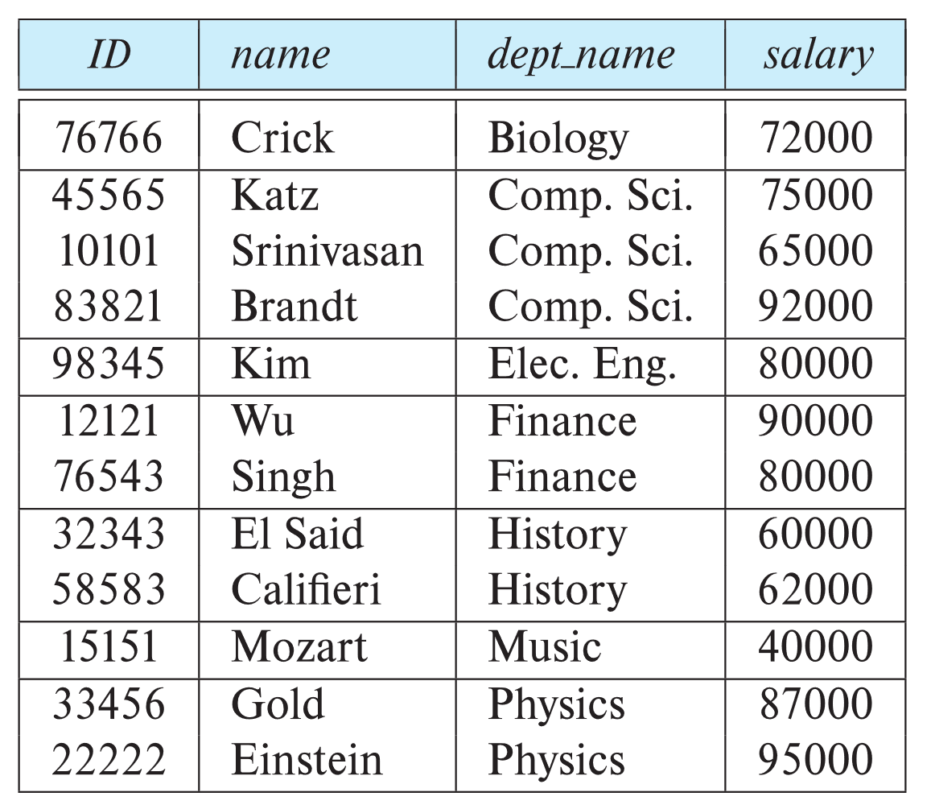
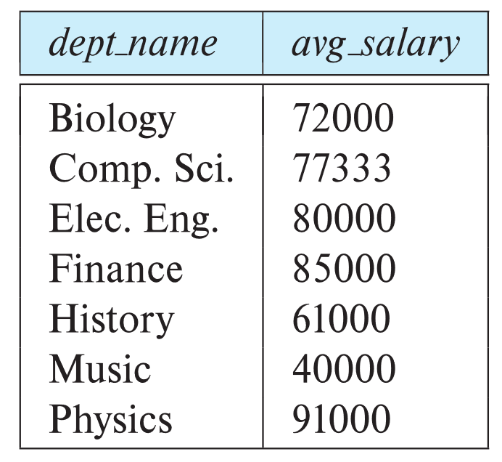
Aggregate Functions – Group By
Find the average salary of instructors in each department
  select dept_name, avg (salary) as avg_salary
  from instructor
  group by dept_name;

Slide 36
Aggregation (Cont.)
Attributes in select clause outside of aggregate functions must appear in group by list
  /* erroneous query */
  select dept_name, ID, avg (salary)
  from instructor
  group by dept_name;

Slide 37
Aggregate Functions – Having Clause
Find the names and average salaries of all departments whose average salary is greater than 42000
Note: predicates in the having clause are applied after the formation of groups whereas predicates in the where clause are applied before forming groups
select dept_name, avg (salary) as avg_salary
from instructor
group by dept_name
having avg (salary) > 42000;

Slide 38
Nested Subqueries
SQL provides a mechanism for the nesting of subqueries. A subquery is a select-from-where expression that is nested within another query.
The nesting can be done in the following SQL query
select A₁, A₂, ..., A_{n}
from r₁, r₂, ..., r_{m}
where P
as follows:
  From clause: r_{i} can be replaced by any valid subquery
  Where clause: P can be replaced with an expression of the form:
  B <operation> (subquery)
  B is an attribute and <operation> to be defined later.
  Select clause:
    A_{i} can be replaced be a subquery that generates a single value.

Slide 39
Set Membership

Slide 40
Set Membership
Find courses offered in Fall 2017 and in Spring 2018
Find courses offered in Fall 2017 but not in Spring 2018
select distinct course_id
from section
where semester = 'Fall' and year= 2017 and
course_id in (select course_id
from section
where semester = 'Spring' and year= 2018);
select distinct course_id
from section
where semester = 'Fall' and year= 2017 and
course_id not in (select course_id
from section
where semester = 'Spring' and year= 2018);

Slide 41
Set Membership (Cont.)
Name all instructors whose name is neither “Mozart” nor Einstein”
select distinct name
from instructor
where name not in ('Mozart', 'Einstein')
Find the total number of (distinct) students who have taken course sections taught by the instructor with ID 10101
Note: Above query can be written in a much simpler manner.
The formulation above is simply to illustrate SQL features
select count (distinct ID)
from takes
where (course_id, sec_id, semester, year) in
(select course_id, sec_id, semester, year
from teaches
where teaches.ID= 10101);

Slide 42
Subqueries in the From Clause

Slide 43
Subqueries in the Form Clause
SQL allows a subquery expression to be used in the from clause
Find the average instructors’ salaries of those departments where the average salary is greater than $42,000.”
  select dept_name, avg_salary
  from ( select dept_name, avg (salary) as avg_salary
  from instructor
  group by dept_name)
  where avg_salary > 42000;
Note that we do not need to use the having clause
Another way to write above query
  select dept_name, avg_salary
  from ( select dept_name, avg (salary)
  from instructor
  group by dept_name)
  as dept_avg (dept_name, avg_salary)
  where avg_salary > 42000;

Slide 44
Scalar Subquery
Scalar subquery is one which is used where a single value is expected
List all departments along with the number of instructors in each department
select dept_name,
( select count(*)
from instructor
where department.dept_name = instructor.dept_name)
as num_instructors
from department;
Runtime error if subquery returns more than one result tuple

Slide 45
Modification of the Database
Deletion of tuples from a given relation.
Insertion of new tuples into a given relation
Updating of values in some tuples in a given relation

Slide 46
Deletion
Delete all instructors
delete from instructor
Delete all instructors from the Finance department
delete from instructor
where dept_name= 'Finance’;
Delete all tuples in the instructor relation for those instructors associated with a department located in the Watson building.
delete from instructor
where dept name in (select dept name
from department
where building = 'Watson');

Slide 47
Deletion (Cont.)
Delete all instructors whose salary is less than the average salary of instructors
  Problem: as we delete tuples from instructor, the average salary changes
  Solution used in SQL:
    First, compute avg (salary) and find all tuples to delete
    Next, delete all tuples found above (without recomputing avg or retesting the tuples)
delete from instructor
where salary < (select avg (salary)
from instructor);

Slide 48
Insertion
Add a new tuple to course
insert into course
values ('CS-437', 'Database Systems', 'Comp. Sci.', 4);
or equivalently
insert into course (course_id, title, dept_name, credits)
values ('CS-437', 'Database Systems', 'Comp. Sci.', 4);
Add a new tuple to student with tot_creds set to null
insert into student
values ('3003', 'Green', 'Finance', null);

Slide 49
Insertion (Cont.)
Make each student in the Music department who has earned more than 144 credit hours an instructor in the Music department with a salary of $18,000.
insert into instructor
select ID, name, dept_name, 18000
from student
where dept_name = 'Music' and total_cred > 144;
The select from where statement is evaluated fully before any of its results are inserted into the relation.
Otherwise queries like
insert into table1 select * from table1
would cause problem

Slide 50
Updates
Give a 5% salary raise to all instructors
  update instructor
  set salary = salary * 1.05
Give a 5% salary raise to those instructors who earn less than 70000
update instructor
set salary = salary * 1.05
where salary < 70000;
Give a 5% salary raise to instructors whose salary is less than average
update instructor
set salary = salary * 1.05
where salary < (select avg (salary)
from instructor);

Slide 51
Updates (Cont.)
Increase salaries of instructors whose salary is over $100,000 by 3%, and all others by a 5%
  Write two update statements:
  update instructor
  set salary = salary * 1.03
  where salary > 100000;
  update instructor
  set salary = salary * 1.05
  where salary <= 100000;
  The order is important
  Can be done better using the case statement (next slide)

Slide 52
Case Statement for Conditional Updates
Same query as before but with case statement
update instructor
set salary = case
when salary <= 100000 then salary * 1.05
else salary * 1.03
end

Slide 53
End of Chapter 3

